Slide 1


DFT for Catalysis Summer School
CP2K IO and Timing for Small Systems
Woodrow N. Wilson, Neeraj Rai
Dave C. Swalm School of Chemical Engineering and Center for Advanced Vehicular Systems, Mississippi State University, USA
June 3rd , 2022

Slide 2

CP2K: Open-Source Electronic Structure & Molecular Dynamics
An ab initio molecular dynamics package for a wide variety of systems
Solid and Liquid State
Molecular and Periodic
Material and Biological Sciences
Quickstep | Simulation Types | Other Perks
Gaussian-Plane Wave Method | Molecular Dynamics & Monte Carlo | Open Source
Orbital Transform | QM/MM with FIST | More Features Added Regularly
Local Resolution-of-Identity | Geometry Optimizations | Link with Gromacs
Semi-Empirical Methods | Nudged Elastic Band Methods | Easy to Learn
Kühne, T. D.; et. al. CP2K: An Electronic Structure and Molecular Dynamics Software Package - Quickstep: Efficient and Accurate Electronic Structure Calculations. J. Chem. Phys. 2020, 152 (19).
Notes:
888 atoms in 2x2x1 MWW slab
Important considerations of lignin solvolysis are temperature, residence time, solvent density, solid loading, hydrogen source, catalyst, and pressure.

Slide 3


Gaussian Type Orbitals vs. Plane Waves
Basis Set | Pros | Cons
Gaussian Type Orbitals (GTO) | Atomic Orbital Like Compact Functions (15 – 20 per Atom) Analytic for most QM Operators Fourier Transform is a Gaussian Compact Support | Non-orthogonal Linear Dependencies Hard to Make and Improve BSSE Molecules and Solids Electron Repulsion Integrals
Plane Waves | Orthogonal Independent of Atomic Positions Naturally Periodic Systematically Improvable Complete Basis Set | Naturally Periodic Many Functions Needed
$$φ\left(r\right)=r^{l} Y_{lm}\left(\hat{r}\right)\exp{[−α{\left(r−A\right)}^{2}]}$$
$$χ\left(r\right)= \sum_{k}{d_{k}φ\left(r\right)}$$
$$φ(r)=\frac{1}{\sqrt{Ω}}\exp{[iG∙r]}$$
Introduction to CP2K (1/7) - Gaussian and Plane Waves Method (prof. Jürg Hutter)
Link: https://www.youtube.com/watch?v=v2vnZbhNEpw&list=PLrmNhuZo9sgYJqeTWUhdhtYu3Ol988prg
Notes:
888 atoms in 2x2x1 MWW slab
Important considerations of lignin solvolysis are temperature, residence time, solvent density, solid loading, hydrogen source, catalyst, and pressure.

Slide 4
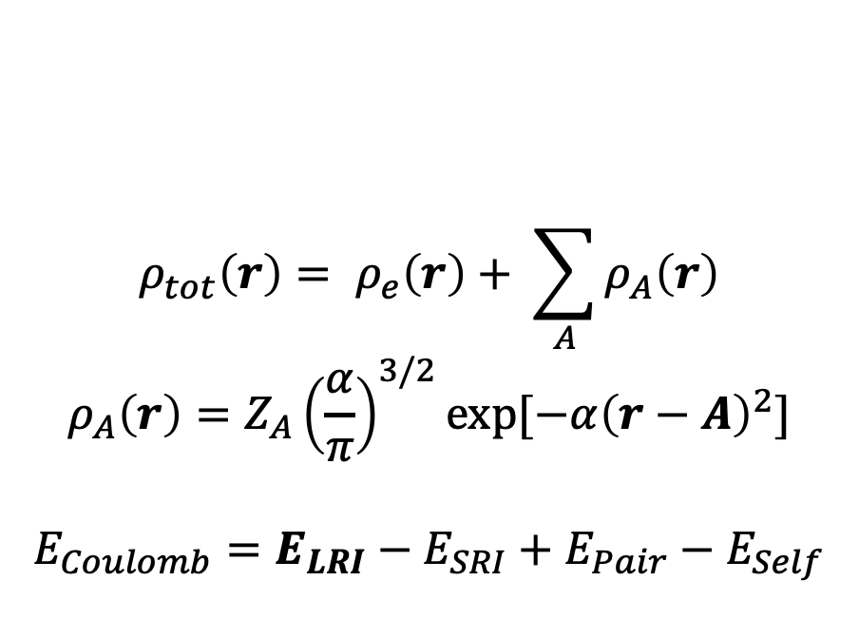
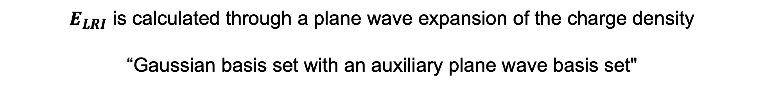
Quickstep and the GPW Method
Avoid calculation of ERI by defining the total charge density as the sum of electronic and gaussian atomic charges.
$$ρ_{tot}\left(r\right)= ρ_{e}\left(r\right)+ \sum_{A}{ρ_{A}\left(r\right)}$$
$$ρ_{A}\left(r\right)=Z_{A}{\left(\frac{α}{π}\right)}^{3/2}\exp{[−α{\left(r−A\right)}^{2}]}$$
$$E_{Coulomb}=E_{LRI}−E_{SRI}+E_{Pair}−E_{Self}$$
$E_{LRI}$ is calculated through a plane wave expansion of the charge density
“Gaussian basis set with an auxiliary plane wave basis set"
Notes:
888 atoms in 2x2x1 MWW slab
Important considerations of lignin solvolysis are temperature, residence time, solvent density, solid loading, hydrogen source, catalyst, and pressure.

Slide 5
CP2K IO
Main CP2K Input File
Name and extension are arbitrary
cp2k.inp
H2O.geo-opt
Optional Inputs
Coordinate Files
$CP2K_DATA_DIR
Pseudopotentials
Basis Sets
Can also provide in main input
Command
$ cp2k.ssmp –i cp2k.inp –o cp2k.out
$ srun cp2k.psmp –i cp2k.inp –o cp2k.out
Typical Job Outputs
Log file
PROJECT-1.restart
PROJECT-pos-1.xyz
PROJECT-1.ener
PROJECT-1.cell
PROJECT-RESTART.wfn
Many more output options can be controlled in the input file
Charge Density
Mulliken / Hirshfeld Charges
Hartree Potential
Notes:
888 atoms in 2x2x1 MWW slab
Important considerations of lignin solvolysis are temperature, residence time, solvent density, solid loading, hydrogen source, catalyst, and pressure.

Slide 6
CP2K Input File Basics
CP2K Input is Organized by Sections
&SECTION
KEYWORD1 [units] 450
KEYWORD1 40
KEYWORD2 .TRUE.
…
&SECTION ON
&END
…
&END SECTION
CP2K Input Parsing Features
@INCLUDE filename (copy text from file)
@SET VAR value (define variable)
$VAR (call variable)
@IF / @ENDIF (logic)
! / # (Comments)
Tabs are not necessary
Most units in CP2K are atomic units, with a few exceptions:
CUTOFF → Ry
Atomic Coordinates → Å
Notes:
888 atoms in 2x2x1 MWW slab
Important considerations of lignin solvolysis are temperature, residence time, solvent density, solid loading, hydrogen source, catalyst, and pressure.

Slide 7
CP2K Main Sections
&GLOBAL ! Controls Basic Job Settings
…
&END GLOBAL
&FORCE_EVAL ! How to Calculate Forces
…
&SUBSYS ! Atom Coordinates And Cell Info
…
&END SUBSYS
…
&END FORCE_EVAL
&MOTION ! How the Atoms Move
…
&END MOTION
&VIBRATIONAL_ANALYSIS ! Normal Mode and Phonon Analysis
…
&END VIBRATIONAL_ANALYSIS
Notes:
888 atoms in 2x2x1 MWW slab
Important considerations of lignin solvolysis are temperature, residence time, solvent density, solid loading, hydrogen source, catalyst, and pressure.

Slide 8
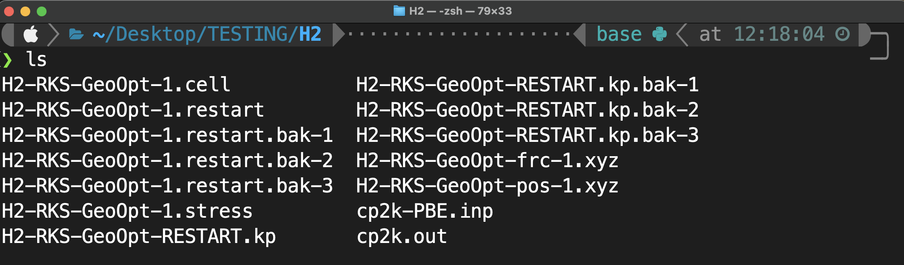
H₂ Geometry Optimization
DFT
XC Functional: PBE
Basis Set: DZVP-MOLOPT-SR
PW Cutoff: 450 Ry
Pseudopotential: GTH
SCF Convergence: 10⁻⁵
K-Points: 1x1x1 M.P.
Spin: Restricted
System
1 H₂ Molecule
8 Å x 8 Å x 8 Å Cubic Cell
Geo. Opt. With atoms starting 1 Å apart
Computer
OMP Threads: 4
Processor: 3.2 GHz 8-Core Intel Xeon W
Time: 35.5 seconds
Directory Contents
Notes:
888 atoms in 2x2x1 MWW slab
Important considerations of lignin solvolysis are temperature, residence time, solvent density, solid loading, hydrogen source, catalyst, and pressure.

Slide 9
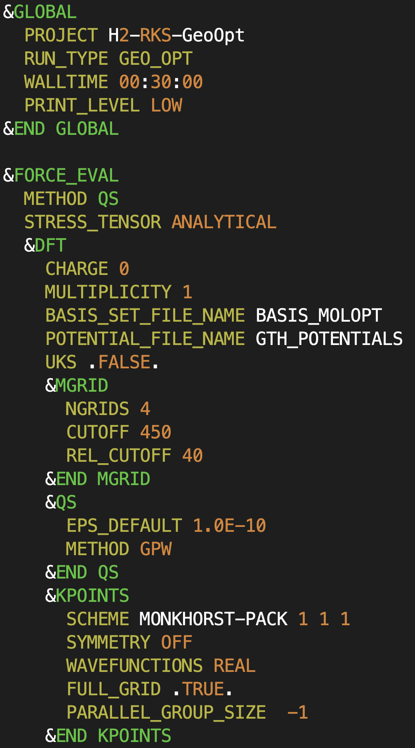
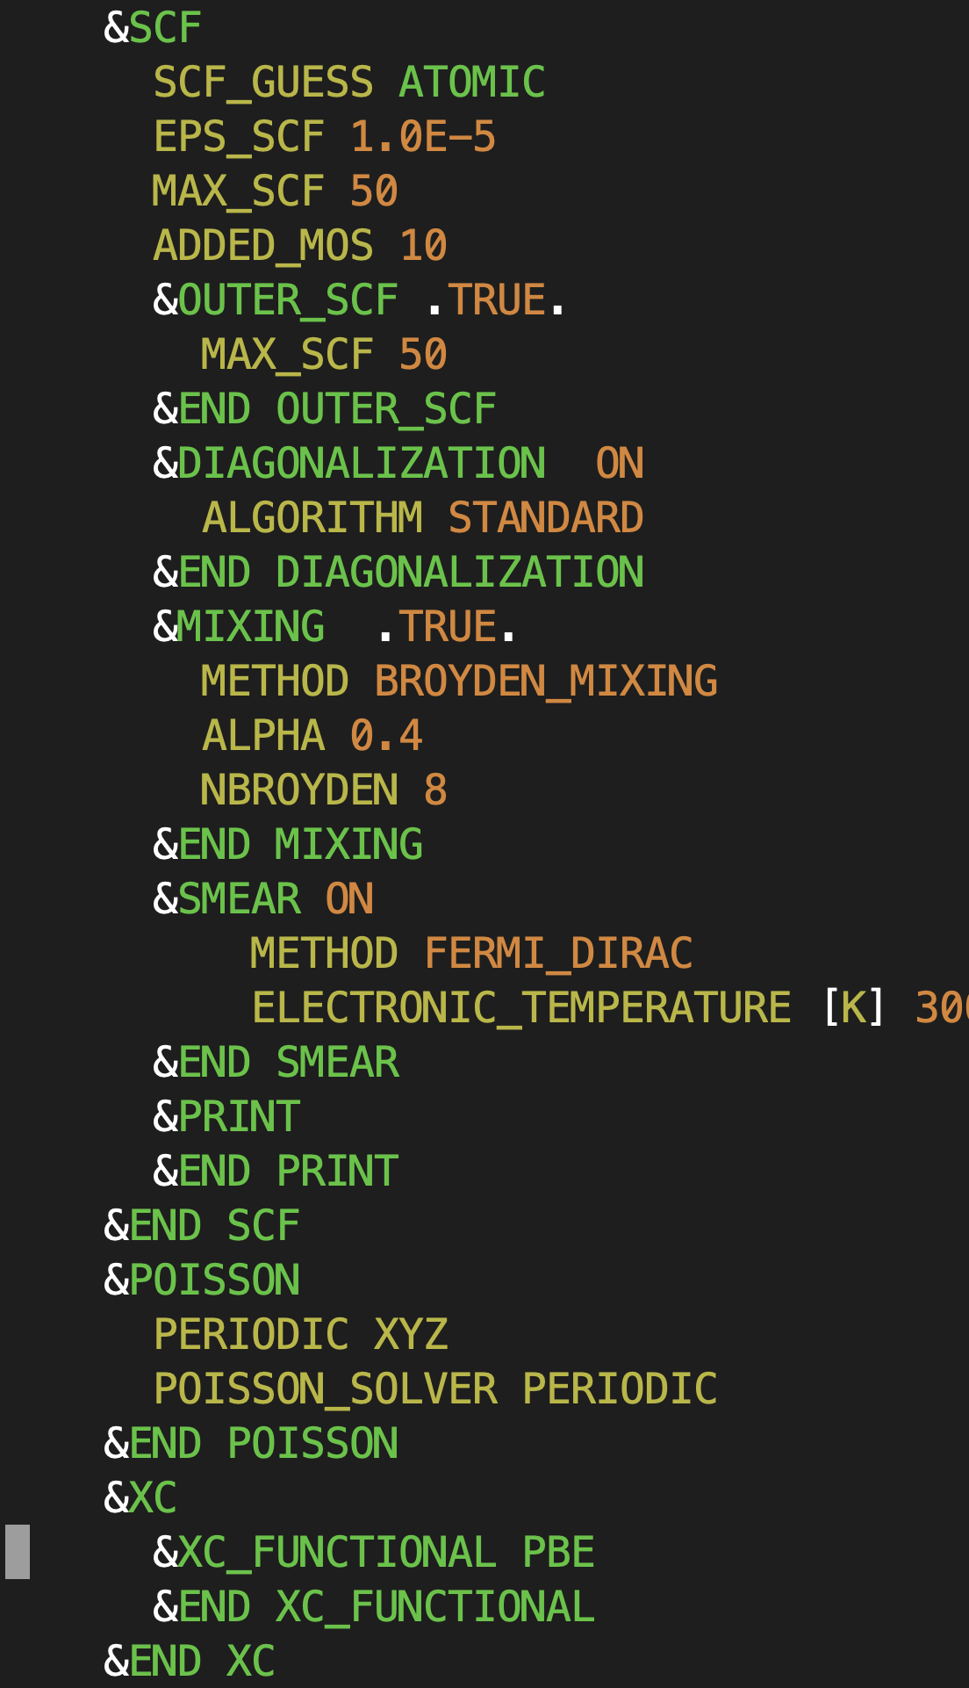
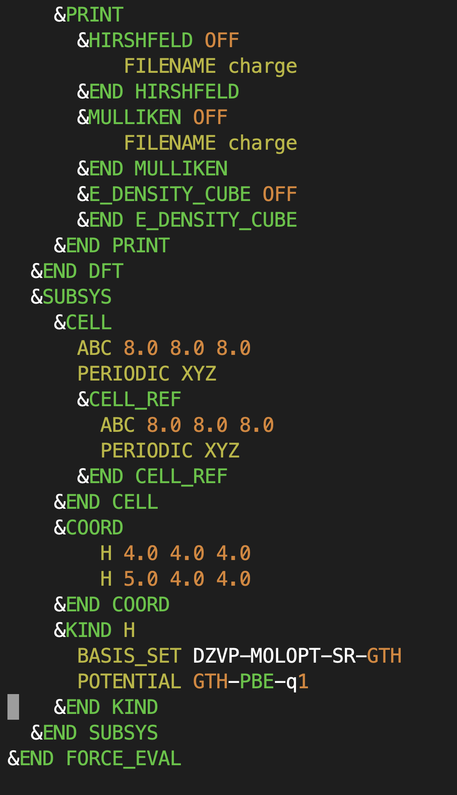
H₂ Geometry Optimization
Notes:
888 atoms in 2x2x1 MWW slab
Important considerations of lignin solvolysis are temperature, residence time, solvent density, solid loading, hydrogen source, catalyst, and pressure.

Slide 10
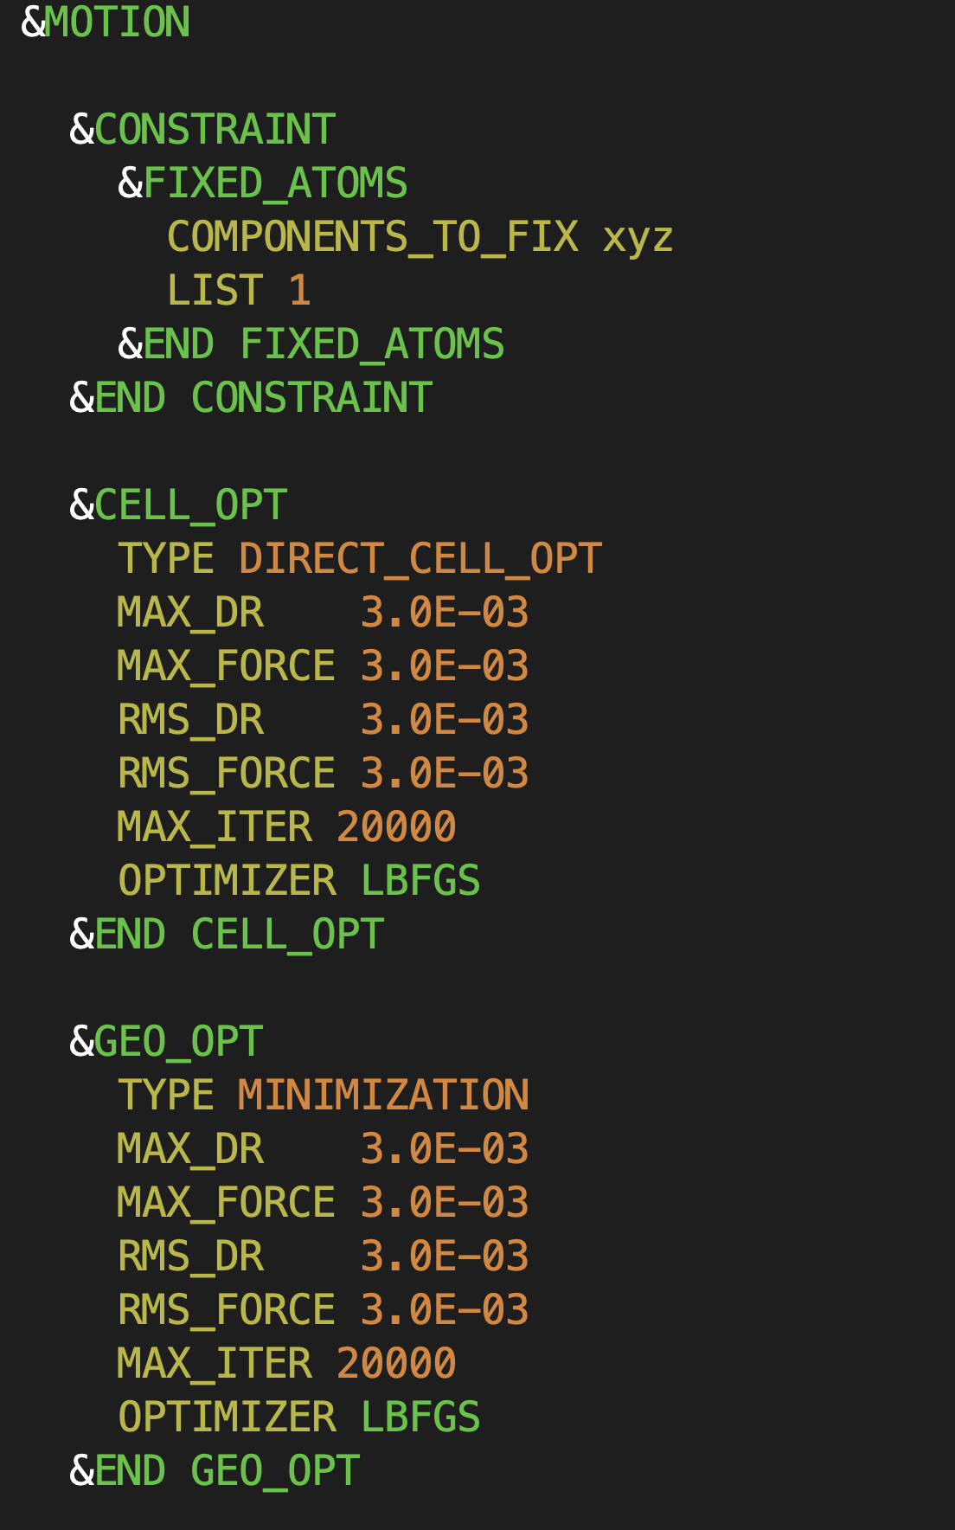
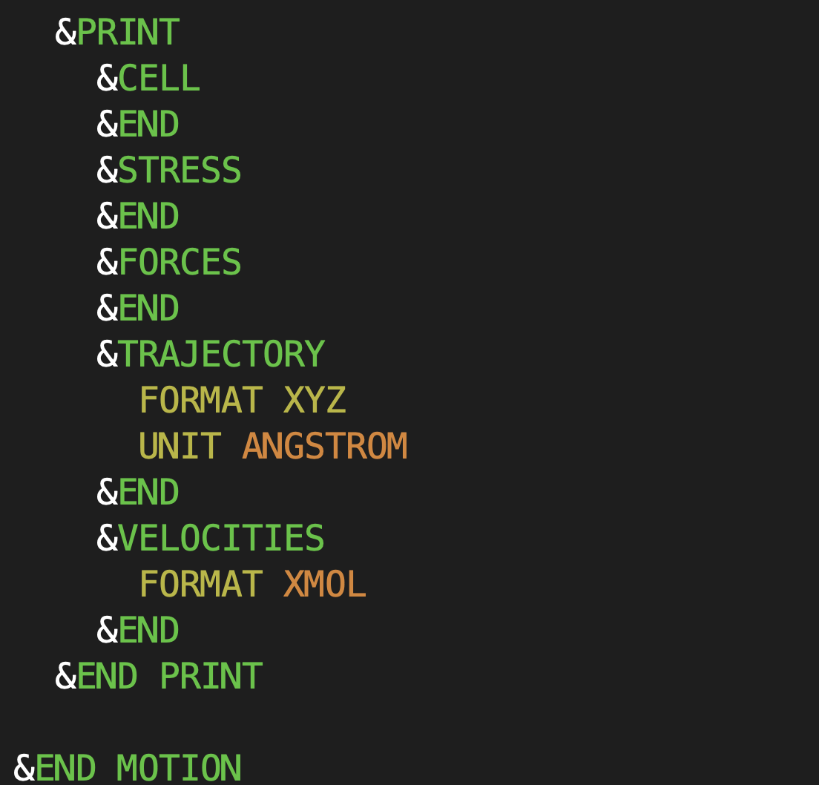
H₂ Geometry Optimization
Notes:
888 atoms in 2x2x1 MWW slab
Important considerations of lignin solvolysis are temperature, residence time, solvent density, solid loading, hydrogen source, catalyst, and pressure.

Slide 11
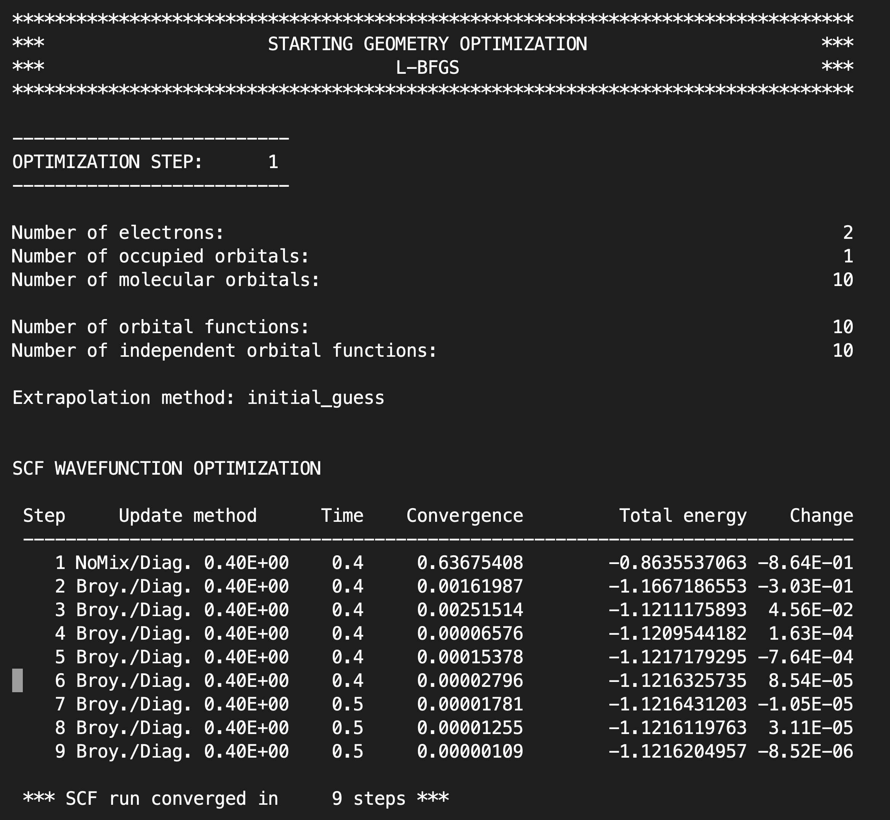
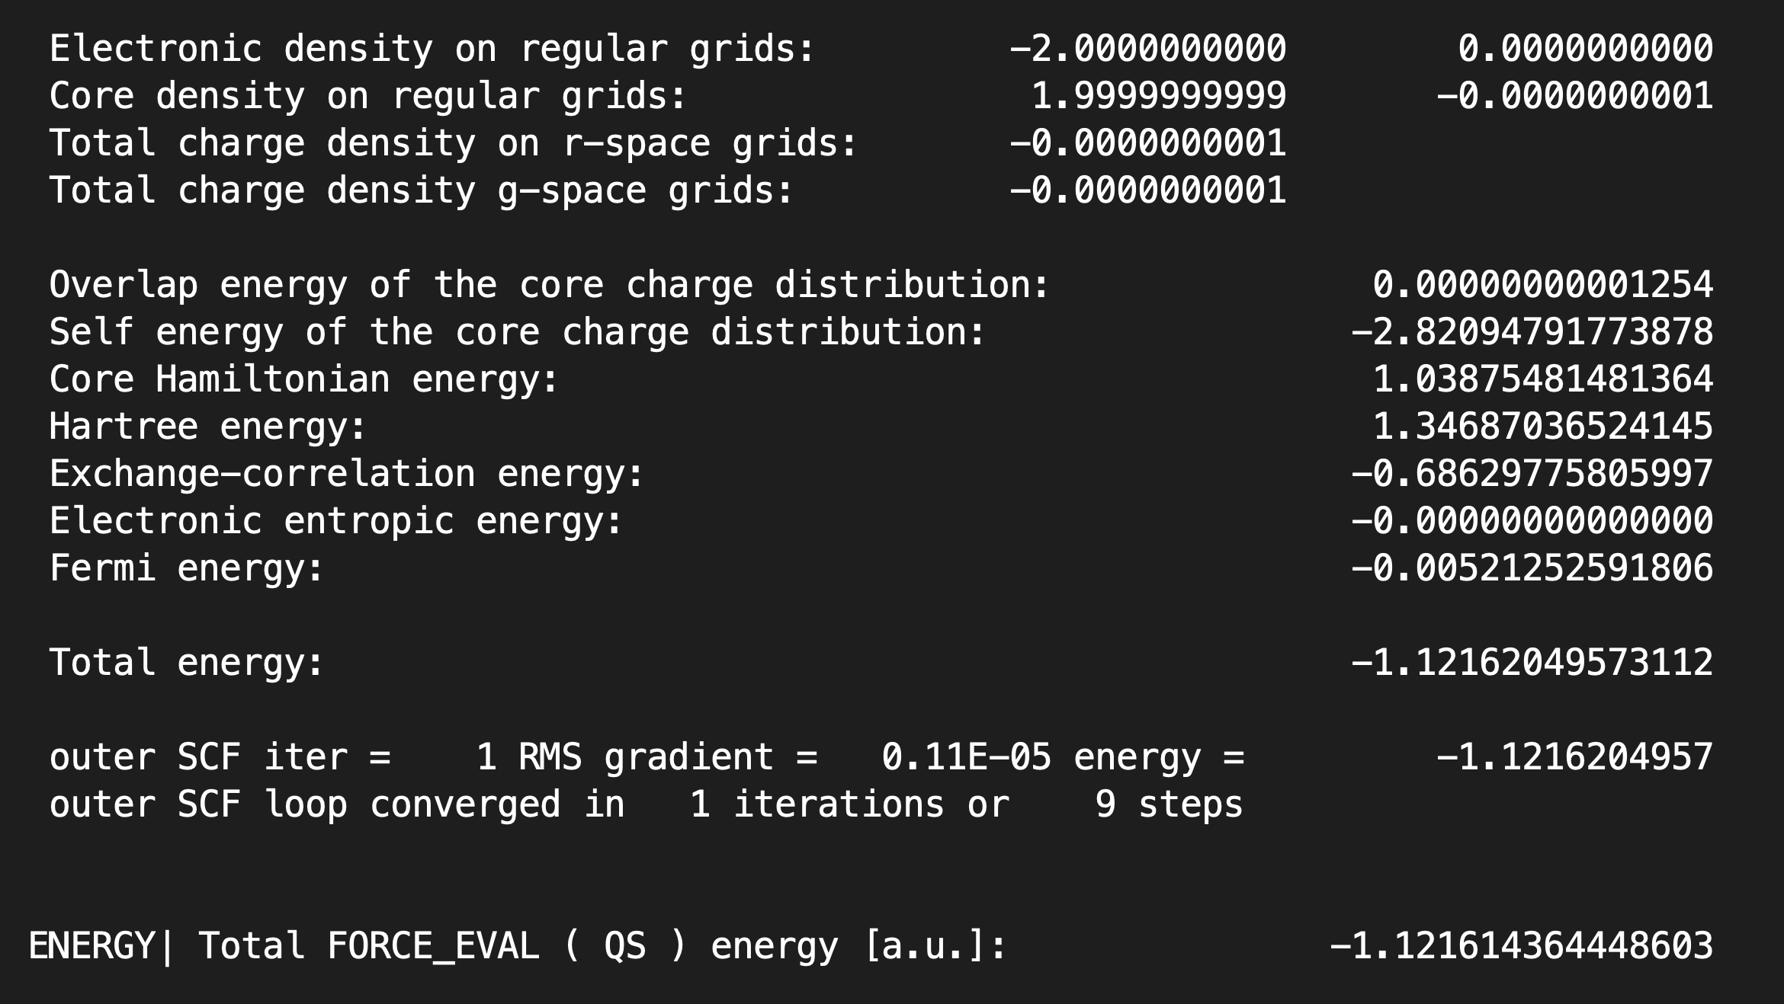
H₂ Geometry Optimization
1 Hartree = 2 Ry
= 627.5 kcal / mol
= 27.2114 eV
Notes:
888 atoms in 2x2x1 MWW slab
Important considerations of lignin solvolysis are temperature, residence time, solvent density, solid loading, hydrogen source, catalyst, and pressure.

Slide 12
H₂ Geometry Optimization
Notes:
888 atoms in 2x2x1 MWW slab
Important considerations of lignin solvolysis are temperature, residence time, solvent density, solid loading, hydrogen source, catalyst, and pressure.

Slide 13
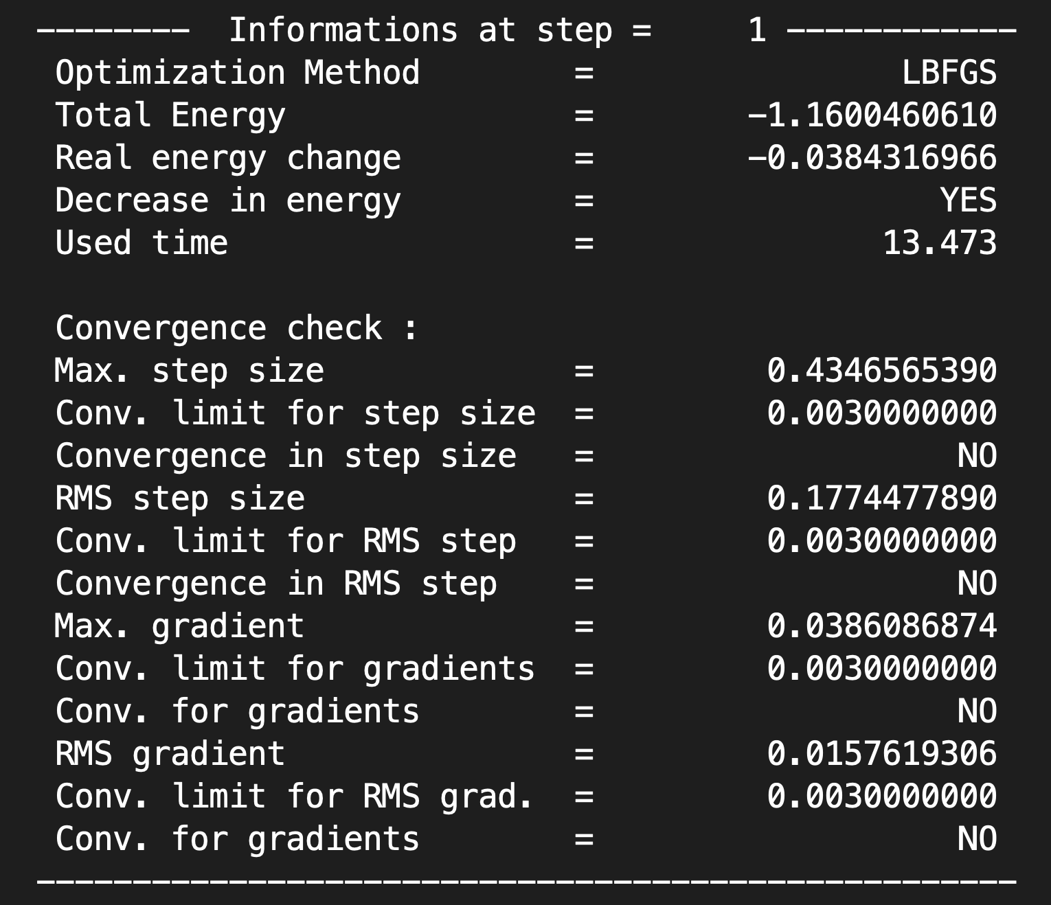
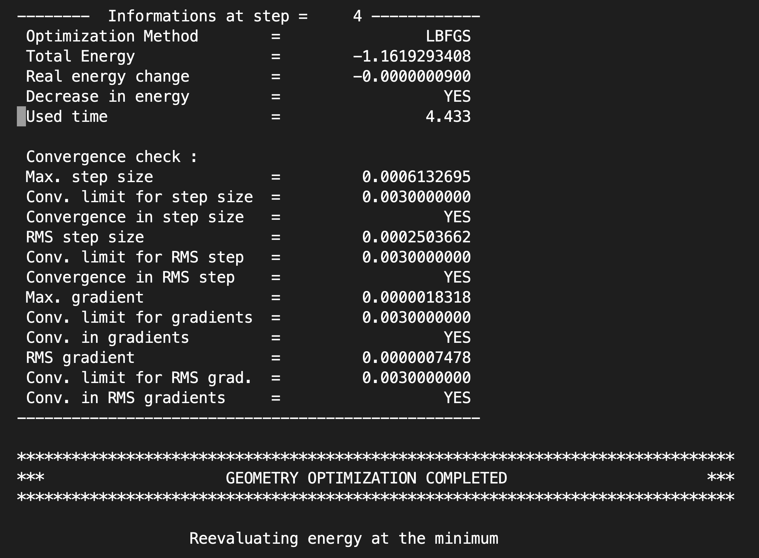
H₂ Geometry Optimization
A nice trick to check this at the command line:
$ grep –a12 “Convergence check” cp2k.out
Notes:
888 atoms in 2x2x1 MWW slab
Important considerations of lignin solvolysis are temperature, residence time, solvent density, solid loading, hydrogen source, catalyst, and pressure.

Slide 14
Bulk Pt Single Point Energy
DFT
XC Functional: PBE
Basis Set: DZVP-MOLOPT-SR
PW Cutoff: 450 Ry
Pseudopotential: GTH
SCF Convergence: 10⁻⁵
K-Points: 1x1x1 M.P.
Spin: Unrestricted
System
Bulk FCC Pt
3 x 3 x 3 Supercell
Computer
Orion: 120 Tasks
Processor: Dual 2.4 GHz 20-Core Intel Xeon Gold
Time: 2.8 seconds / SCF Iteration
DFT
XC Functional: PBE
Basis Set: DZVP-MOLOPT-SR
PW Cutoff: 450 Ry
Pseudopotential: GTH
SCF Convergence: 10⁻⁵
Oribital Transform: DIIS Minimizer
Spin: Unrestricted
System
Bulk FCC Pt
3 x 3 x 3 Supercell
Computer
Orion: 120 Tasks
Processor: Dual 2.4 GHz 20-Core Intel Xeon Gold
Time: 1.4 seconds / SCF Iteration
Notes:
888 atoms in 2x2x1 MWW slab
Important considerations of lignin solvolysis are temperature, residence time, solvent density, solid loading, hydrogen source, catalyst, and pressure.

Slide 15
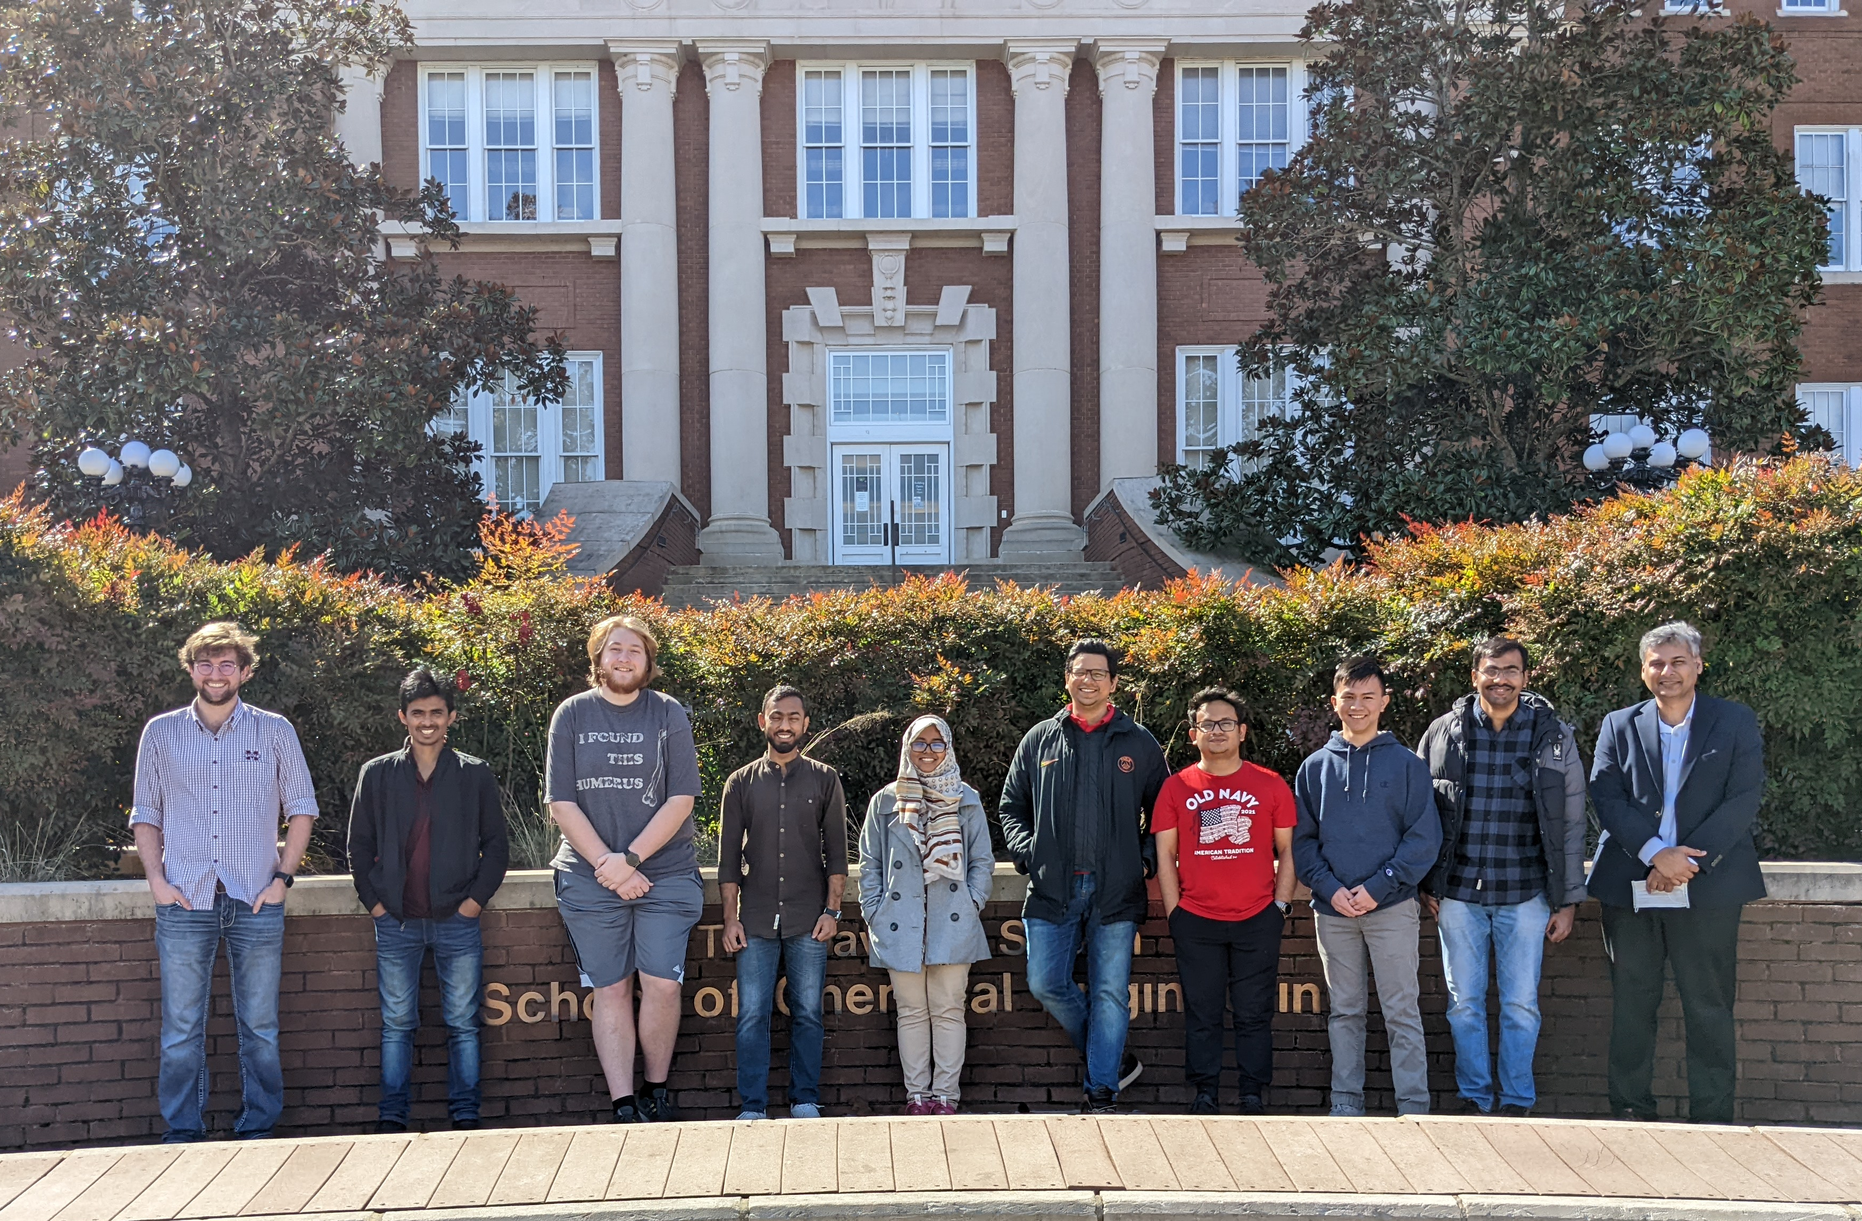
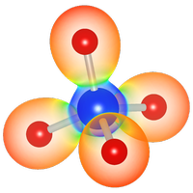


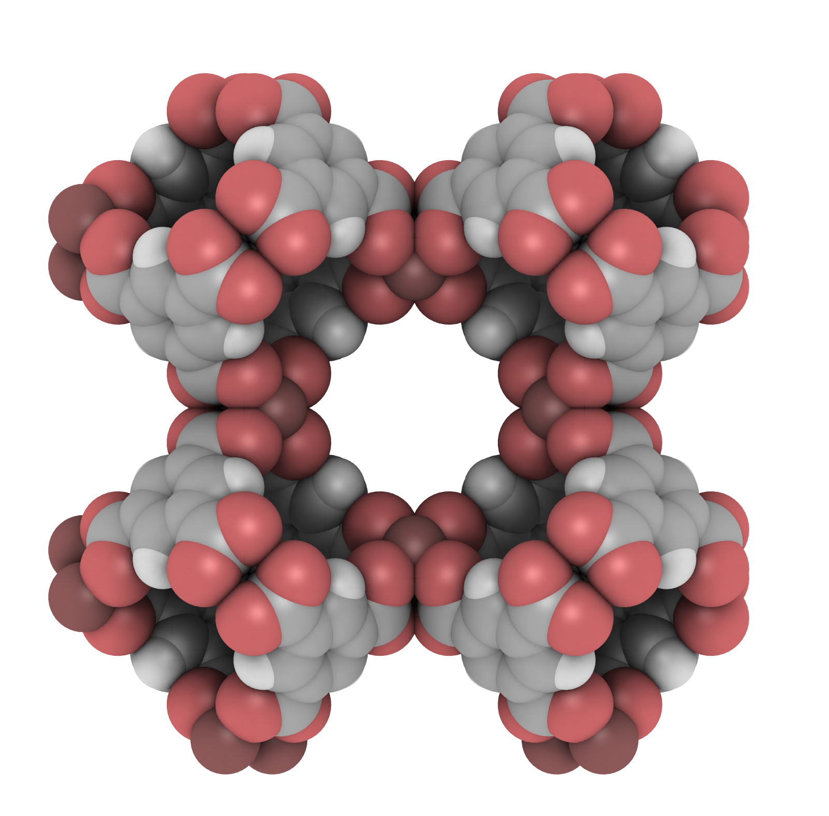






Acknowledgements
MSU Molecular Science and Engineering Laboratory
Software
Funding
PI & Advisor
Dr. Neeraj Rai (MSU)
Undergraduate Researchers
John Michael Lane
Quyen (Peter) Tran
Justin Whittington
Committee Members
Dr. Santanu Kundu (MSU)
Dr. Dong Meng (MSU)
Dr. Yizhi Xaing (MSU)
Dr. Vivek S. Bharadwaj (NREL)
Computational Resources

Slide 16
DFT for Catalysis Summer School
CP2K IO and Timing Information for Small Systems
Woodrow N. Wilson, Neeraj Rai
Dave C. Swalm School of Chemical Engineering and Center for Advanced Vehicular Systems, Mississippi State University, USA
June 3rd , 2022

